Slide 1
Langualiser
Robust Learning Ltd
In Cooperation with Kamil Truszkowski
Presents
Your Future Languagemate

Slide 2
Contents
01
02
03
04
05
06
Introduction
Available Languages
Design Concept
Features
Development Timeline
Conclusion

Slide 3
Introduction
01

Slide 4
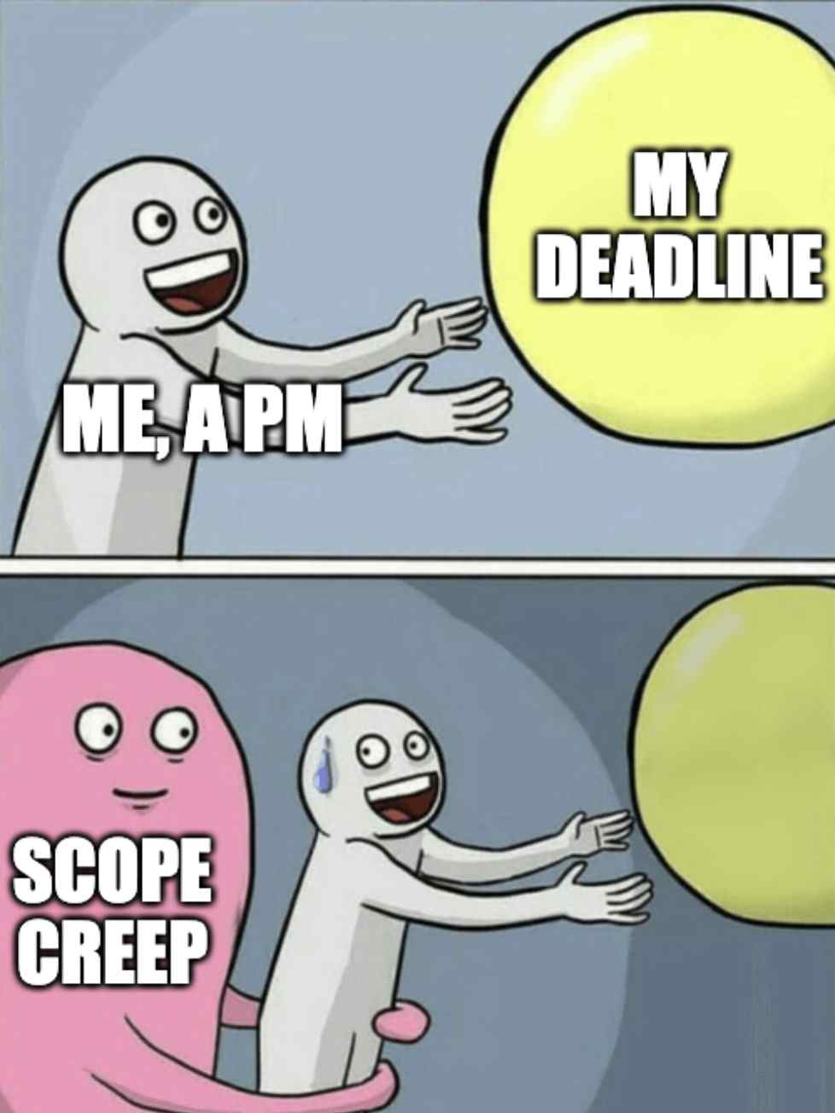
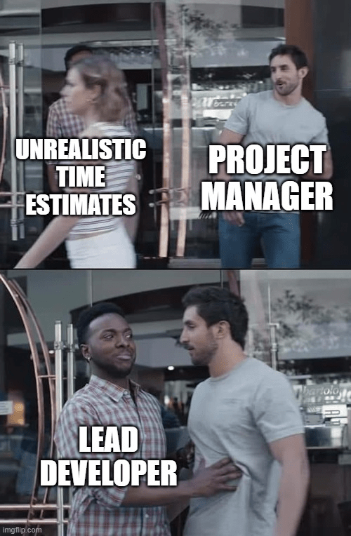

Overview of Langualiser Project
Project Scope
Timeline
Resource Allocation
We simply decided to create something better than Duolingo :D
We will try to beat duolingo in one year since publishing Langulaiser, and we give ourselves one year to create it
We already allocated people, PM, Sponsors, BA, Developers Team, Marketing team and
We have 800k PLN and might to do it!

Slide 5


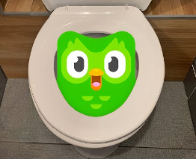
Mission and Vision of Robust Learning Ltd.
Mission Statement
To provide innovative language learning solutions for individuals and businesses worldwide.
Vision Statement
To become a global leader in language education through cutting-edge technology and personalized learning experiences.

Slide 6
Available Languages
02

Slide 7
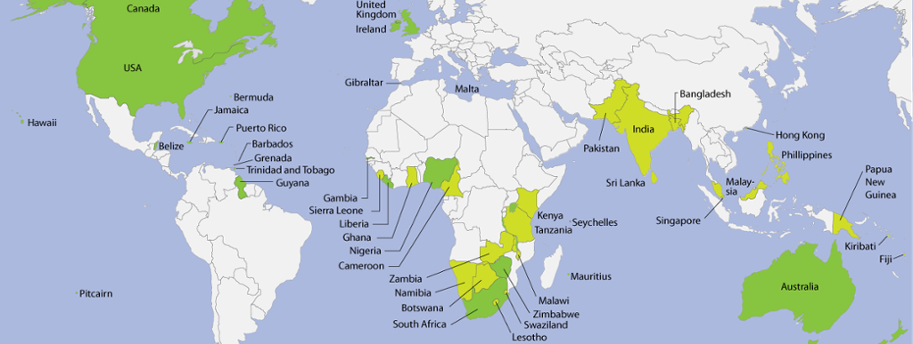
English Language Module
Module Features
Target Audience
Includes grammar, vocabulary, pronunciation, and listening exercises, in future we will add speaking clubs with natives from USA, UK and Australia
Designed for beginners and intermediate English learners

Slide 8
Spanish Language Module
01
Desarrollo del módulo
Planificación y creación de contenido en español para el proyecto Langualiser
02
Integración del módulo
Incorporación del módulo de idioma español en la plataforma Langualiser para usuarios ambos polaco y inglesehablantes

Slide 9
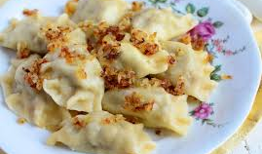
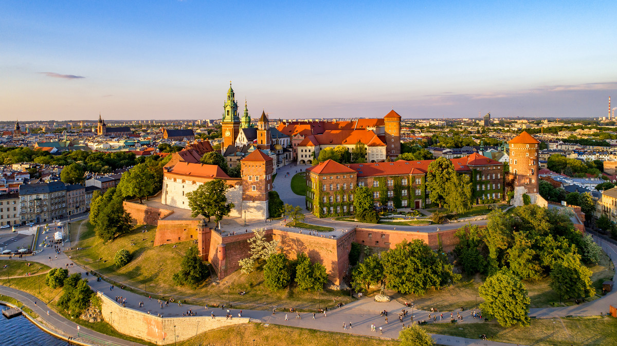
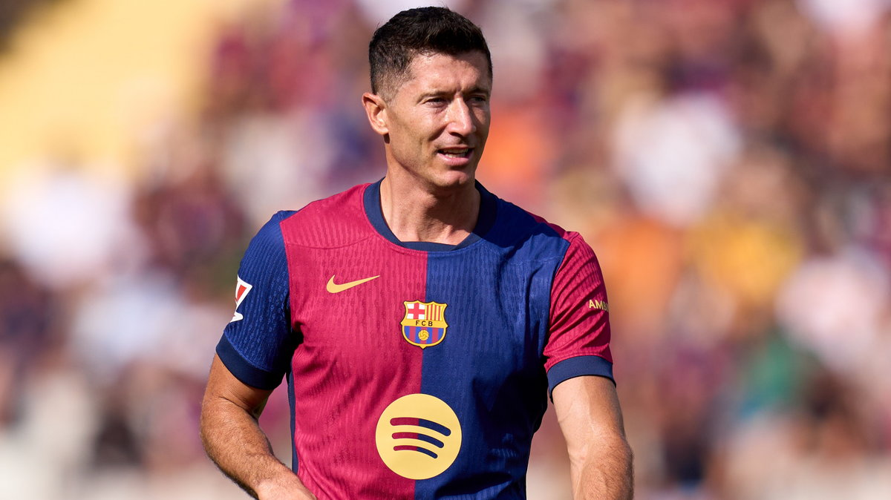
Polish Language Module
Integracja
Tłumaczenia
Testowanie
Integracja modułu języka polskiego do platformy Langualiser
Zapewnienie tłumaczeń interfejsu użytkownika oraz treści na język polski
Przeprowadzenie testów funkcjonalności modułu języka polskiego przed wdrożeniem (co nie jest łatwe)

Slide 10
Design Concept
03

Slide 11
Why We’ve chosen Bordeaux Purple as Main Color?
Elegance and sophistication
Bordeaux purple exudes a sense of elegance and sophistication, perfect for a high-end design concept.
Creativity and uniqueness
Using Bordeaux purple as the main color scheme can help the project stand out with a creative and unique visual identity.
A fact that Bordeaux wine is the most preferred one by our PM is a pure correlation here :D

Slide 12
Features
04

Slide 13

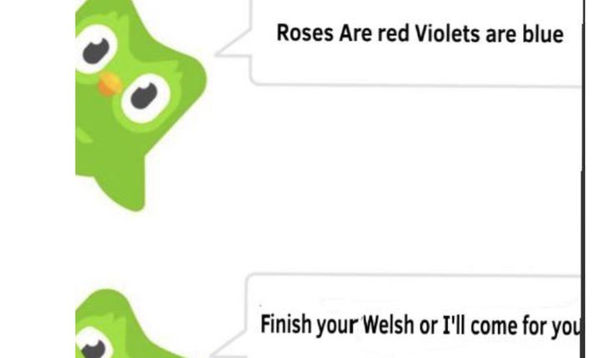


Interactive Language Lessons
Langualiser
Langualiser
Engaging Activities
Real-time Feedback
Personalized Learning
Interactive exercises and games to make learning fun and effective
Receive instant feedback on pronunciation and grammar for improvement
Tailored lessons based on individual progress and goals

Slide 14

Vocabulary Building Tools
L
Langualiser
Your Languagemate
01
Flashcards
02
Word Lists
03
Gamified Learning
Create digital flashcards to enhance vocabulary retention.
Curate personalized word lists for targeted vocabulary practice.
Engage users with interactive games to make vocabulary building fun and effective.

Slide 15

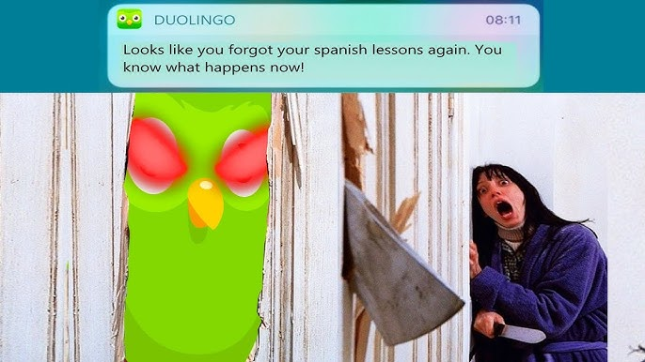

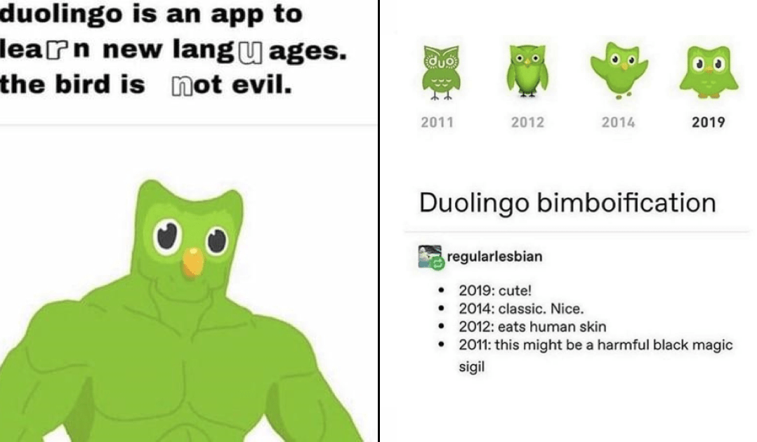


Progress Tracking System
Real-time Updates
Milestone Tracking
Task Assignment
Provides instant progress updates for all project stakeholders
Allows tracking of key milestones to ensure project stays on schedule
Assigns tasks to team members and tracks their completion status

Slide 16
Development Timeline
05

Slide 17

Milestones and Deadlines
Project Kickoff
We gonna start it ASAP we complete the documentation
Prototype Completion
We will have prototype in about 6 months 💪
Final Delivery
We gonna deliver the completed Langualiser project to the public in a year!

Slide 18
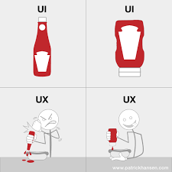
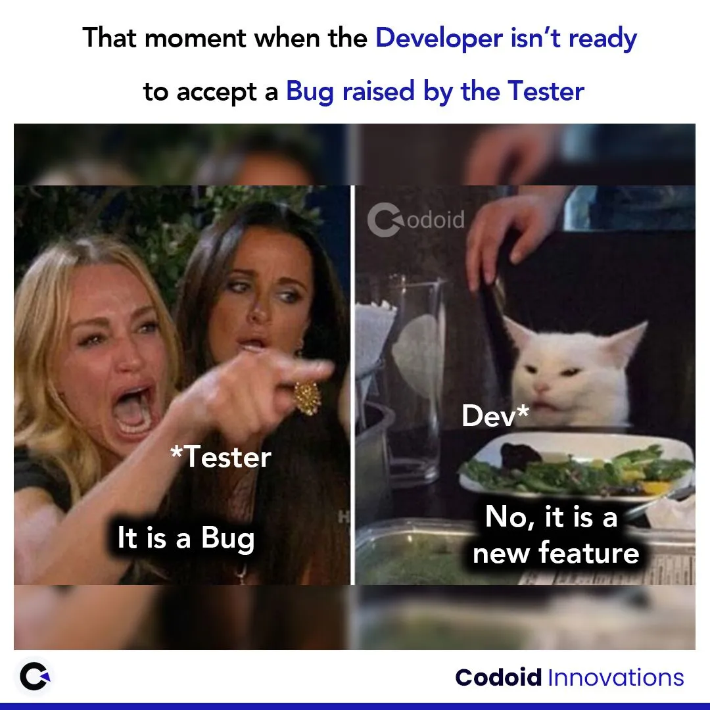
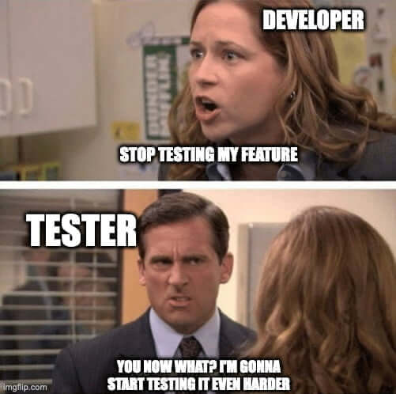
Testing and Feedback Phase
User Testing
Beta Testing
Iterative Improvements
Gather feedback from target users to evaluate usability and functionality
Release the product to a limited audience to identify bugs and gather feedback
Implement changes based on feedback to enhance the product before final release

Slide 19
Conclusion
06

Slide 20
Summary of Langualiser Project
Project Scope
We already defined the objectives, deliverables, and constraints of the Langualiser Project (We will send you all the documents)
Timeline
And we already established a detailed timeline with milestones for the successful completion of the Langualiser Project.

Slide 21
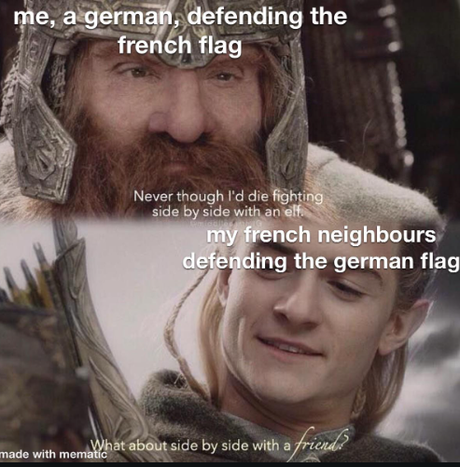
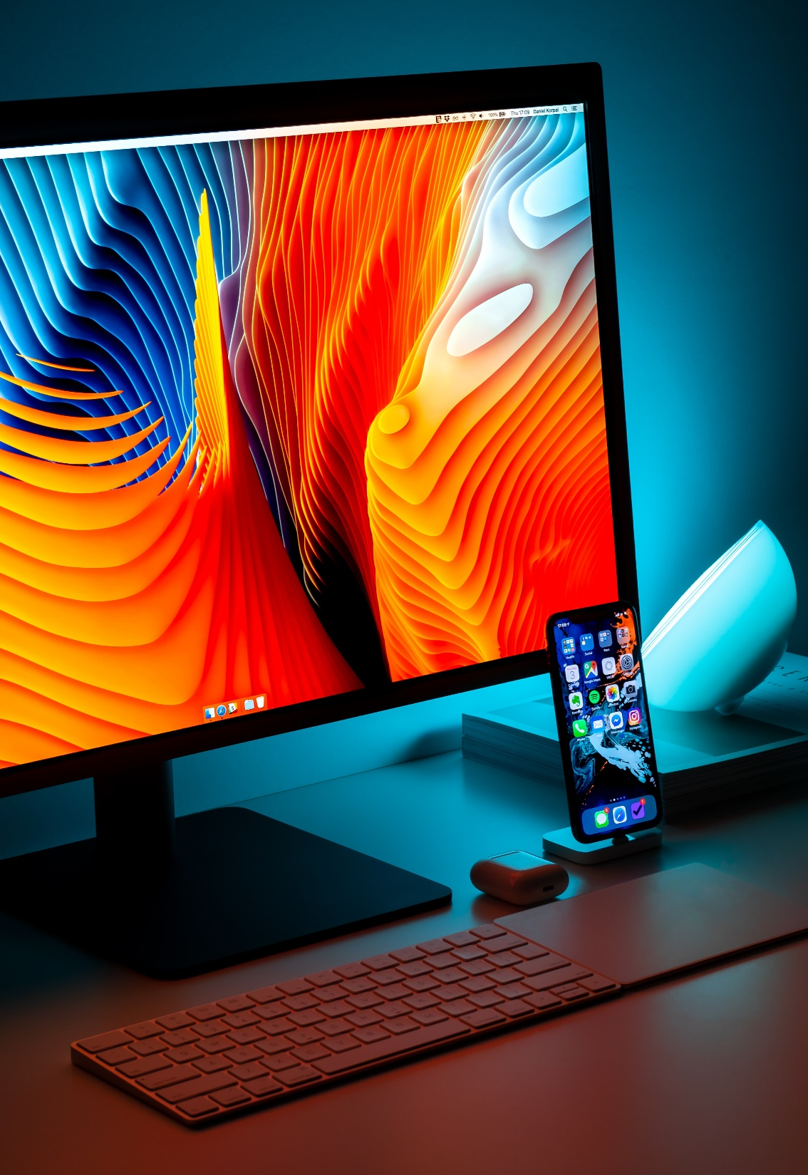
Future Expansion Plans
01
Market Research
Conduct in-depth market research to identify potential new target languages for the Langualiser Project (French and German).
02
Collaboration Opportunities
Explore collaboration opportunities with other language learning platforms (Duolingo does NOT count) to expand the reach and impact of the Langualiser.

Slide 22
Thank You
Kamil Truszkowski

